Slide 1
Spatial analysis for E-bike market in Singapore
SUBmitted by:
Anjali Sinha(A0178476l)
Indu arya(A0178360B)
Nandana murthy(A0178563R)
Prateek Kashyap(A0178248R)
Rubi saini(A0178255W)

Slide 2
introduction
Bicycle sharing is gaining popularity all over the world and Singapore for short distance commute
It is economical and has health benefits
A new e-Bike company wants to enter Singapore and would like to identify most promising customers for first implementation rollout

Slide 3
Objective
We aim to develop mature market for an emerging e-Bike company due to strong commuter cultures that utilize e-Bike for transportation purposes
Our objective is to analyse the current trends and existing conditions which link basic amenities like residential, MRT lines, bus stops, parking stands availability

Slide 4
Data Exploration
We have used data available from different public resources
Different format files such as SHP files, csv files were used
Geocoding of postal codes using R
Tools used are ArcGIS online and ArcGIS pro

Slide 5
Story map

Slide 6
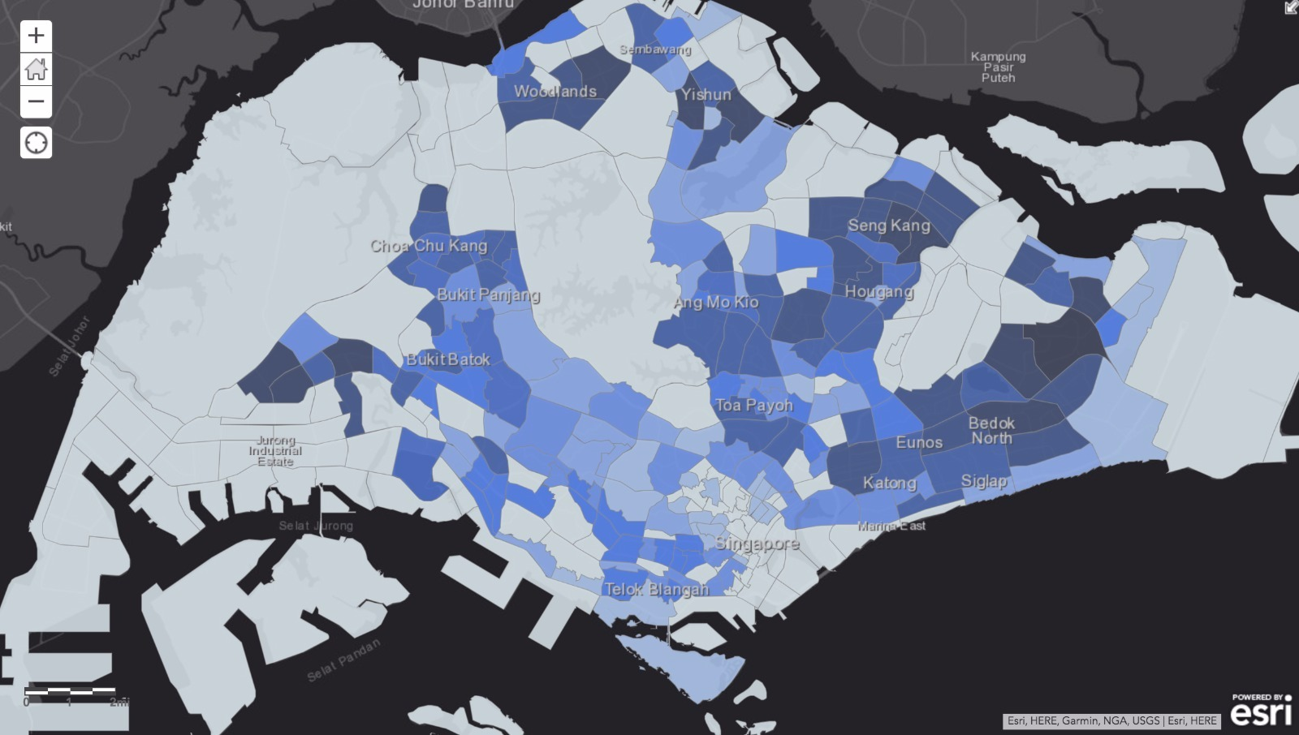
Population Density
The colour in the map shows the density of population in different areas .
We used polygons to plot the regions which can be further analysed for potential outcomes.

Slide 7
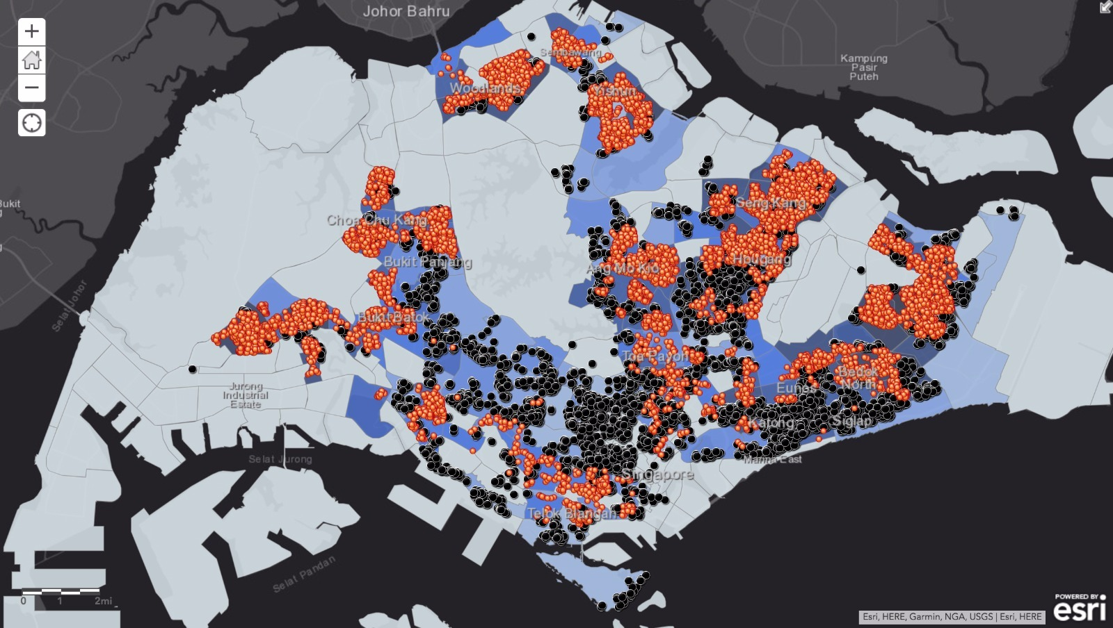
Private & public Residence
Both private and public housing areas are differentiated to analyse the areas with high number of residential units.
Dispersal of points is used for the differentiation of private and public housing areas.

Slide 8
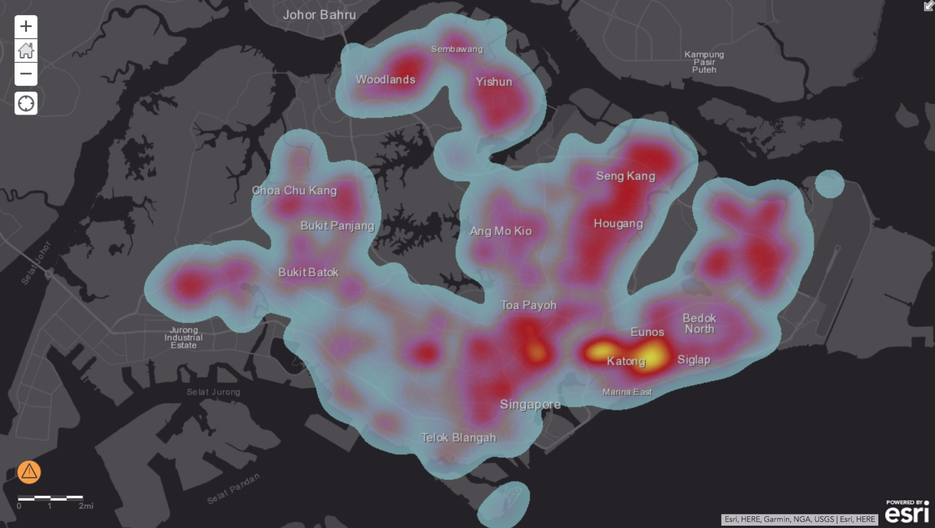
Heat map of residential areas
In this both the public and housing area data are merged to analyse the highly concentrated residential units.
For this heat map is used to show concentration of residential units which shows Woodlands and Sarangoon are the most concentrated areas.

Slide 9
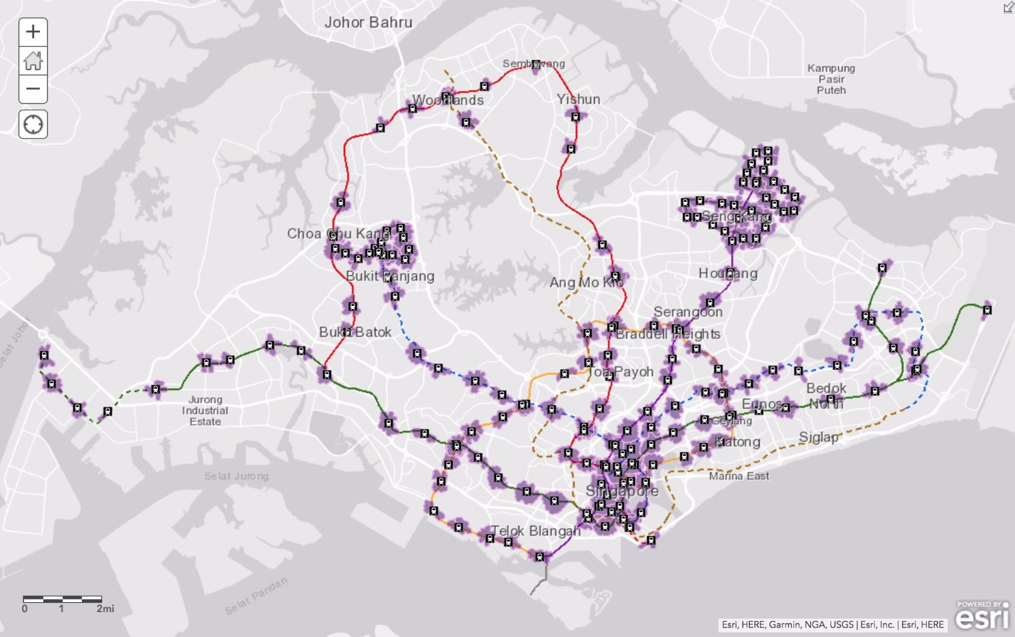
Mrt route
MRT route is plotted for analysing the areas which are within walkable distance to MRT.
Drive time analysis is used to find out this walkable areas within 500 meters from MRT stations.

Slide 10
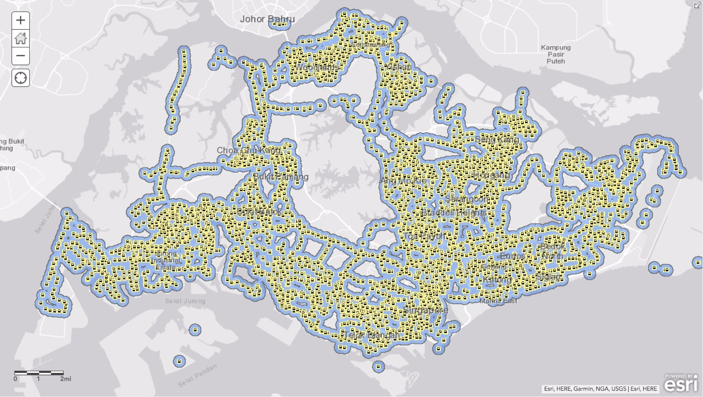
Bus stops
Bus stops are plotted in the map for analysing areas which are within walkable distance to bus stops.
Buffer analysis technique is used to fin out this walkable area within 500 meters from bus stops.

Slide 11
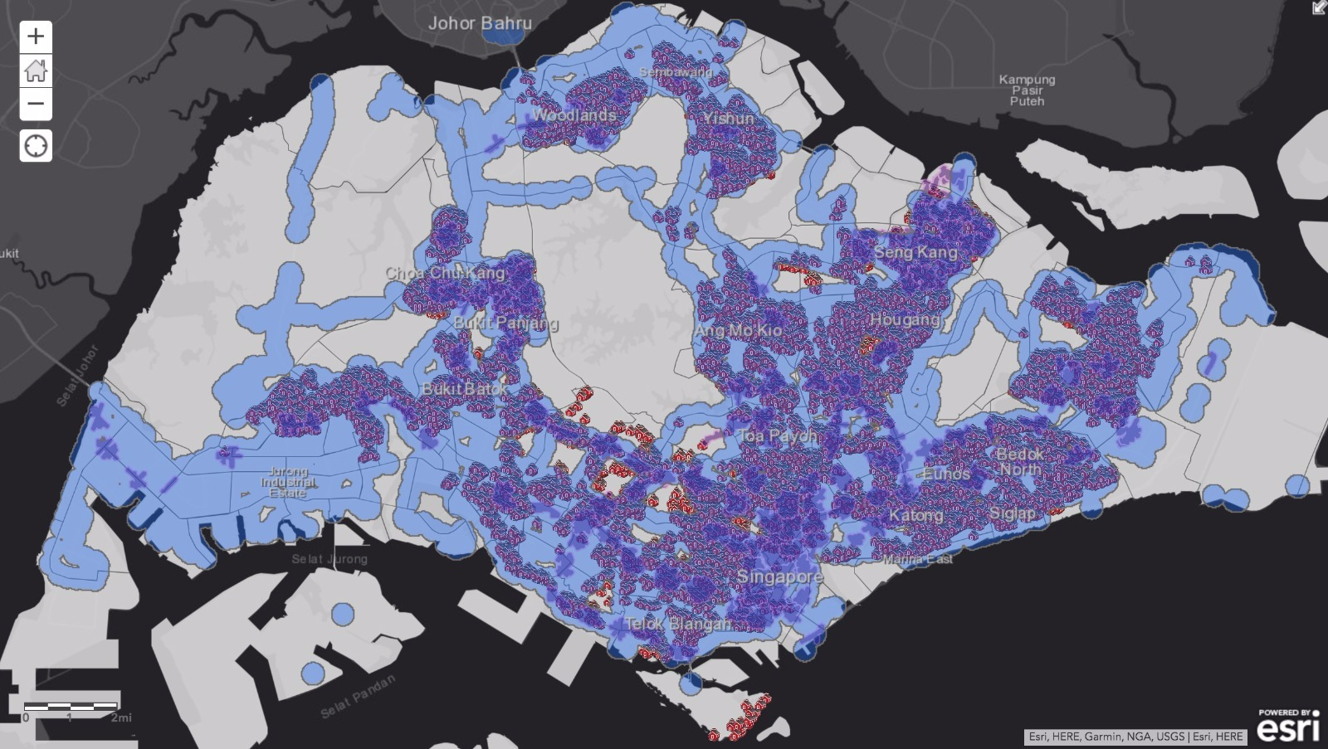
Residence not in coverage area of mrt or bus
It includes the analysis of all the residential units which are not within the walkable distance buffer from MRT or bus stops.
Proximity analysis is used to find out the concerned areas.

Slide 12
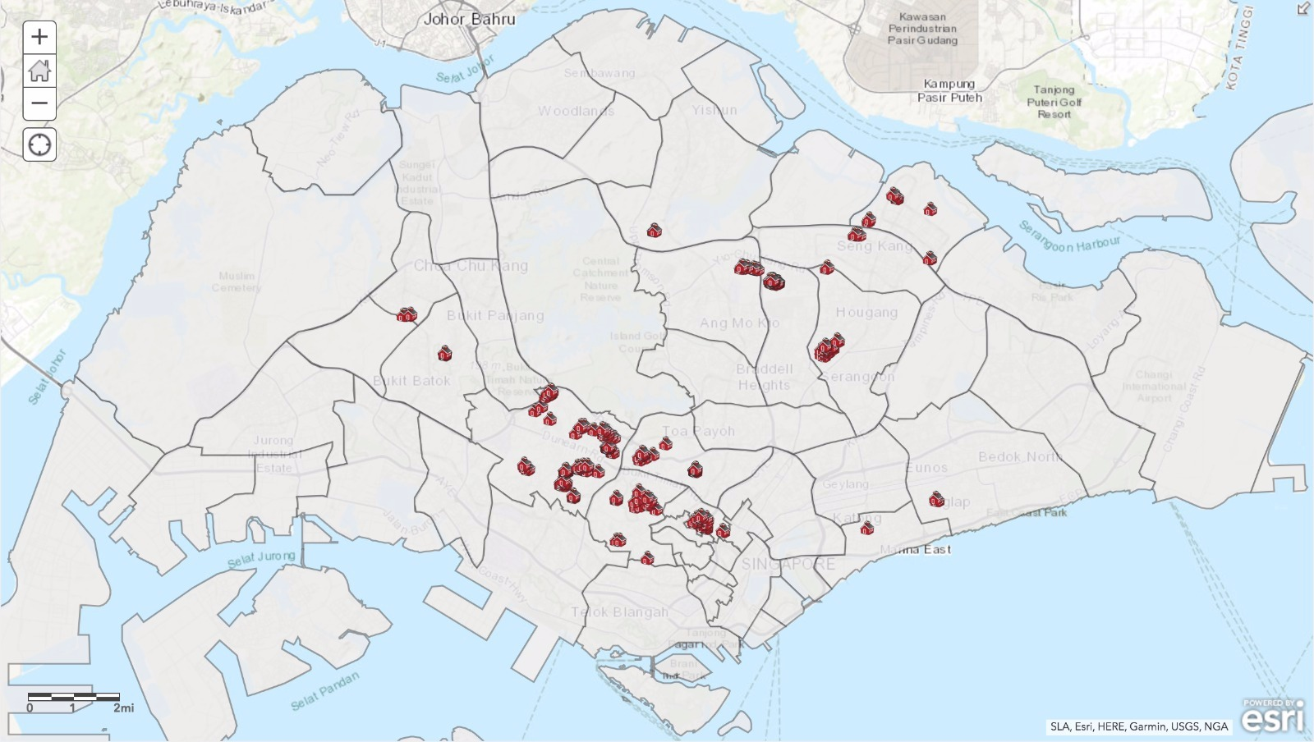
Potential residential area
The areas which are not in walkable distance from MRT or bus stops also known as outliers here are extracted with the help of leveraged overlay tool.

Slide 13
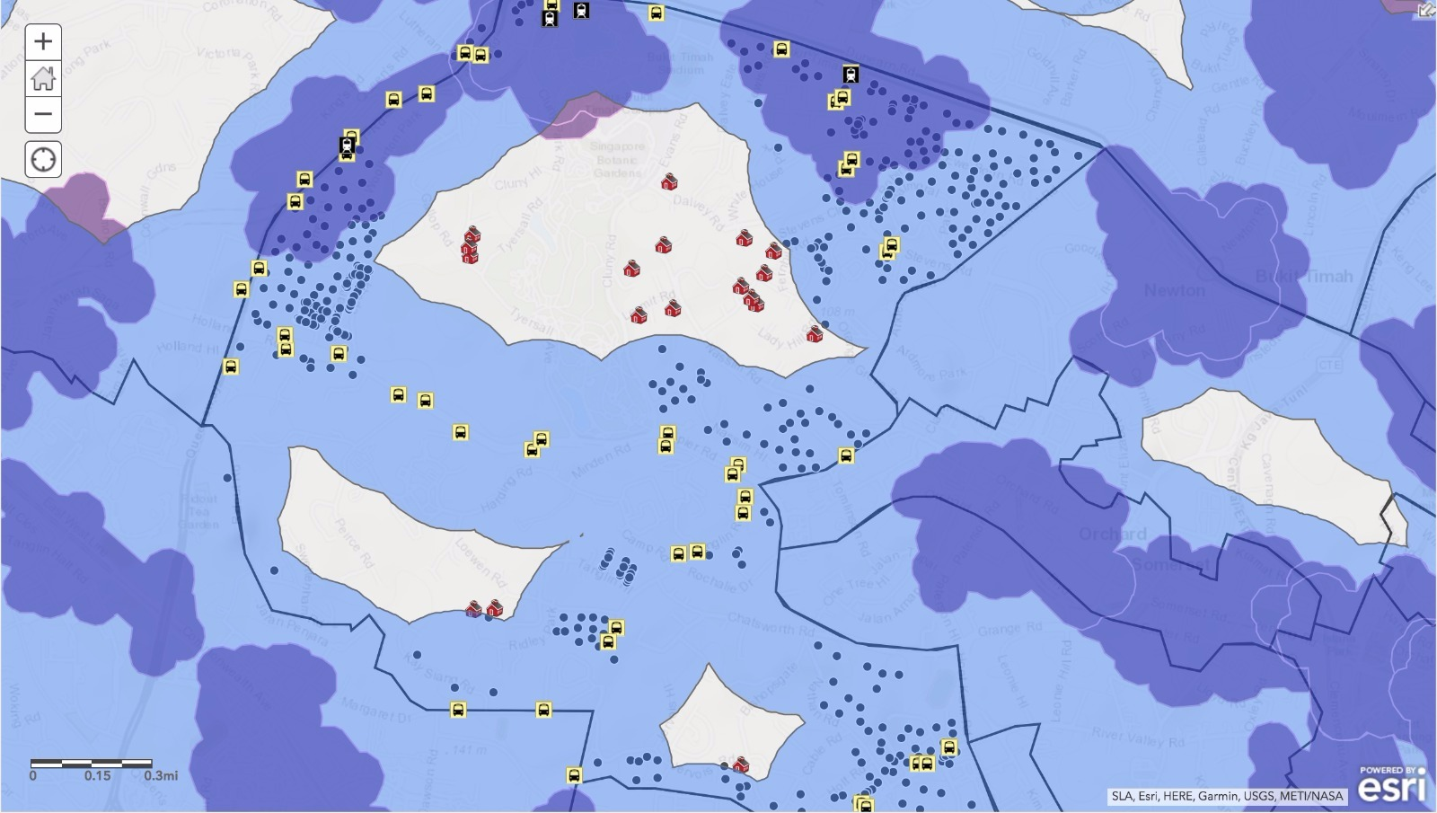
Specific zone analysis- Tanglin
Residential units which do not fall under any public transport coverage area which are known as outliers here, are the potential customers for first rollout.
In this, clipping analysis technique is used to zoom one of the specific zone (Tanglin) to have a closer look.

Slide 14
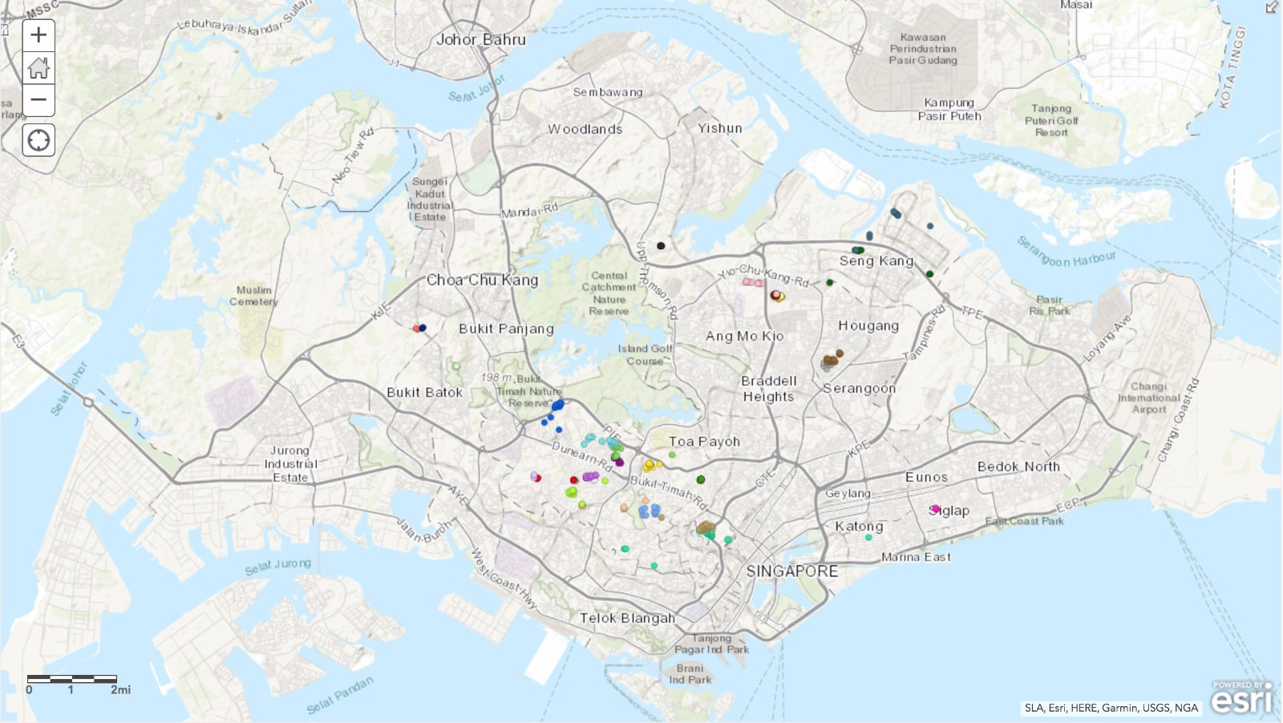
Targeted clusters
Spatially constraint multivariate cluster analysis technique is performed to identify clusters of nearby residential units.
This analysis helps us to find out the optimum locations.

Slide 15
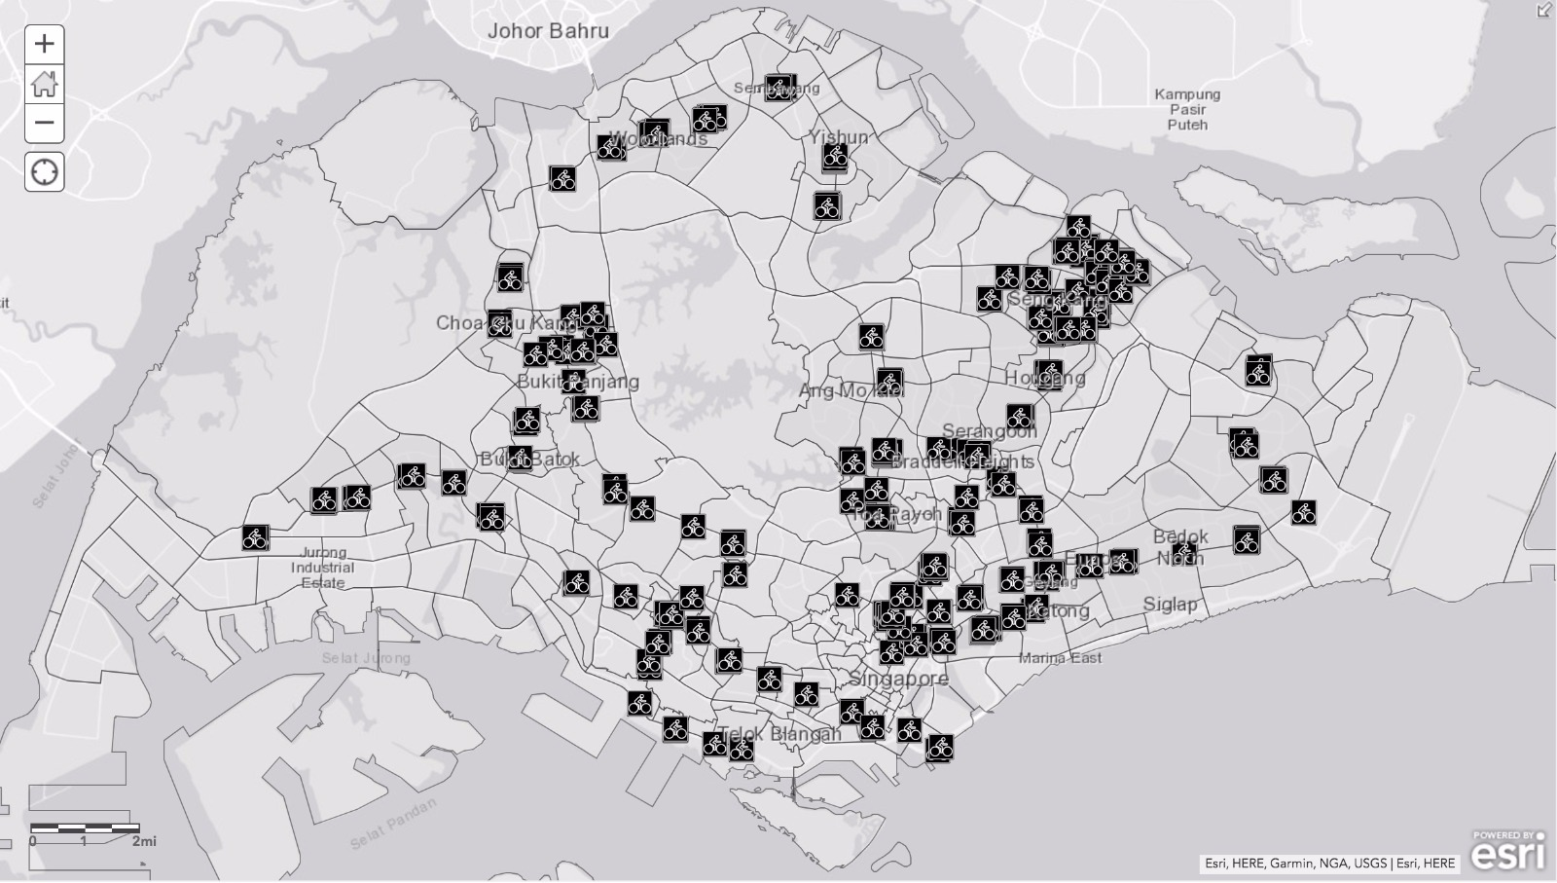
Cycle Stands
This map shows the existing condition of the cycle racks in Singapore.

Slide 16
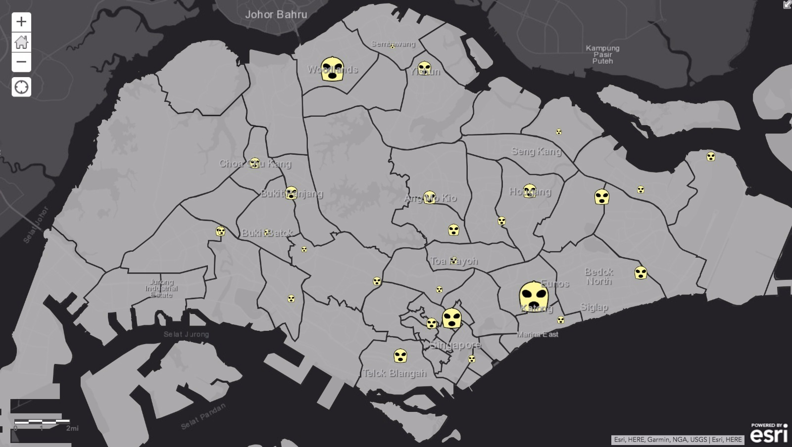
theft analysis
For analysing the crime associated with theft, we plotted the areas having cases reported for theft and robbery.
It was found that Geylang, Woodlands and Rochor are the areas with max number of theft and robbery cases reported.

Slide 17
limitations
We are targeting only residential areas for the first rollout of our bikes.
We are not considering weather conditions for our analysis due to data unavailability.

Slide 18
insights
Tampines, Seng Kang and Woodlands East are densely populated areas indicating good customer base.
Whereas Katong , Woodlands and Serangoon are the areas with maximum concentration of residential units.
Majority of the residential units in Singapore are located far away from MRTs.
Singapore has state-of-art bus network. However, there are still few Residential Units that are located far from MRT's and Bus Stops. These residential units are more promising for the project and should be included in the initial rollout

Slide 19
Thank You!

